Slide 1
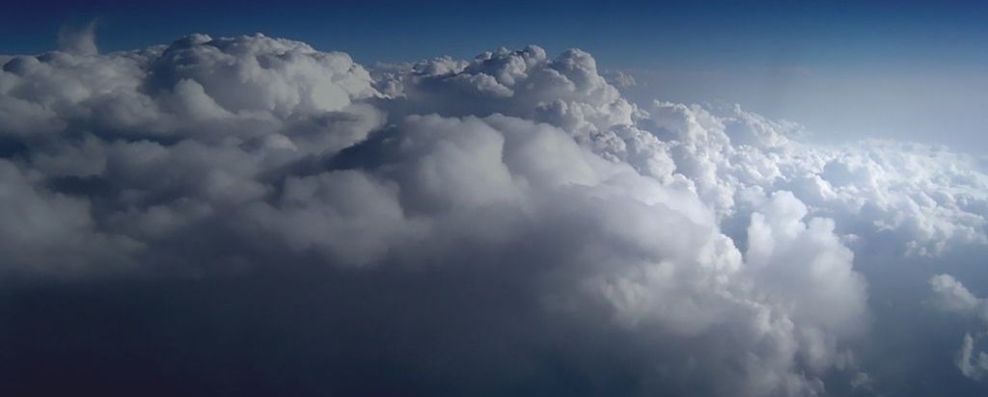
Architecture in the Cloud
https://commons.wikimedia.org/wiki/File:Above_the_Clouds.jpg

Slide 2
Origin of the term “Cloud Computing”*
“Comes from the early days of the Internet where we drew the network as a cloud… we didn’t care where the messages went… the cloud hid it from us” – Kevin Marks, Google
First cloud around networking (TCP/IP abstraction)
Second cloud around documents (WWW data abstraction)
The emerging cloud abstracts infrastructure complexities of servers, applications, data, and heterogeneous platforms
  (“muck” as Amazon’s CEO Jeff Bezos calls it)
*Architectural Implications of Cloud Computing, SATURN 2011, May 18, 2011, © 2011 Carnegie Mellon University
Jeff Bezos’ quote: http://news.cnet.com/8301-13953_3-9977100-80.html?tag=mncol
Kevin Marks quote: http://news.cnet.com/8301-13953_3-9938949-80.html?tag=mncol video interview
Notes:
Jeff Bezos’ quote: http://news.cnet.com/8301-13953_3-9977100-80.html?tag=mncol
Kevin Marks quote: http://news.cnet.com/8301-13953_3-9938949-80.html?tag=mncol video interview

Slide 3
What is Cloud computing?
External compute resources
  No assets owned
Access delivered over the network
Clients are ‘tenants’, not owners
Scalable w/o purchasing new equipment
  Ideally dynamic
Financial model is by usage (vs. by asset)
Notes:
To a degree, cloud computing owes a lot to the dot.com bubble – it built the infrastructure that allowed the internet to become ubiquitous and provide the bandwidth for concepts like cloud computing to grow.
Another founding principle was COTS hardware. The ability to quickly and cheaply source hardware and the fact that it was all the same created a cost effective compute platform to support cloud computing.

Slide 4
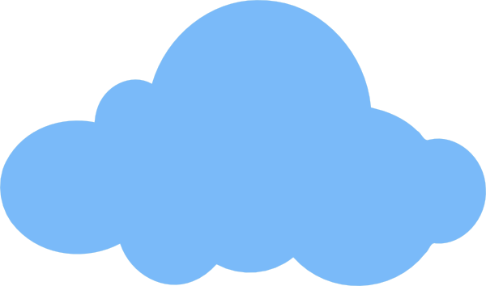
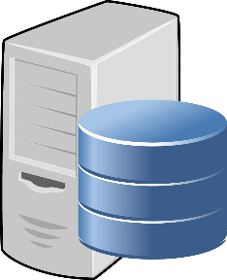

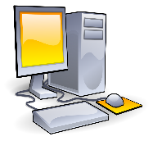

A shift …
ASP1
ASP2
ASP3
Elastic, Multi-tenant
On Premises

Slide 5
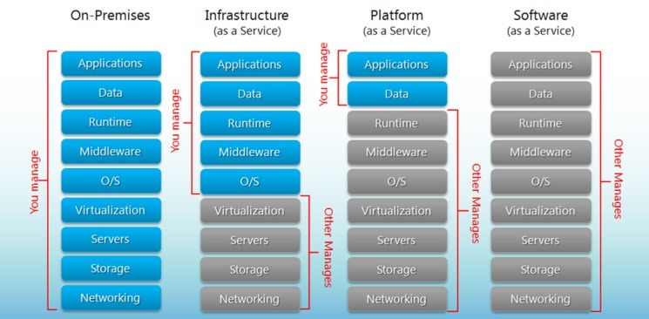
Cloud Service Models
Cloud Infrastructure as a Service (IaaS)
  Rent processing, storage, network capacity, and other fundamental computing resources
    Basically a hosted, rented data-center
Cloud Platform as a Service (PaaS)
  Deploy customer-created applications to a cloud
  Frameworks and platforms (OS, Management,
  Core storage and replication are provided)
Cloud Software as a Service (SaaS)
  Use provider’s applications over a network
  You buy the whole thing!
https://www.bigcommerce.com/blog/saas-vs-paas-vs-iaas/#the-key-differences-between-on-premise-saas-paas-iaas

Slide 6
Visually …
Cloud Infrastructure
SaaS
PaaS
IaaS

Slide 7
Cloud Deployment models
There are multiple deployment models to fit business needs
  Public Cloud
    For the masses
  Private Cloud
    Enterprise owned, but using Cloud Technology
    Can be local, or remote (but segregated)
  Hybrid Cloud
    Combines Public and Private

Slide 8
The NIST Cloud Definition Framework
Hybrid Clouds
Deployment
Models
Private Cloud
Community
Cloud
Public Cloud
Service
Models
Software as a Service (SaaS)
Platform as a Service (PaaS)
Infrastructure as a Service (IaaS)
On Demand Self-Service
Essential
Characteristics
Broad Network Access
Rapid Elasticity
Resource Pooling
Measured Service
Massive Scale
Resilient Computing
Common
Characteristics
Homogeneity
Geographic Distribution
Virtualization
Service Orientation
Low Cost Software
Advanced Security
Notes:
Cloud diagram idea inspired by Maria Spinola 8-31-09

Slide 9
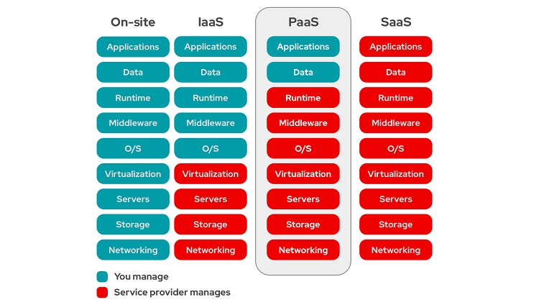
The ‘stack’
PaaS sits between Infrastructure as a Service (IaaS) and Software as a Service (SaaS) in the cloud computing spectrum.
IaaS provides basic computing resources, such as virtual machines and storage, while SaaS offers complete, ready-to-use applications.
PaaS delivers a platform that enables developers to build and deploy custom applications without managing the underlying infrastructure.
e.g. Microsoft Azure App Service, Heroku, IBM Cloud Foundry, and Amazon Web Services Elastic Cloud
15 Popular Platform as a Service (PaaS) Examples - WHSR

Slide 10
Cloud Revenue Models
Common revenue models for As-a-Service
  Charge per unit of ‘consumption’
  Charge per component (or feature/ feature set) per unit of time
  Charge per user per unit of time
All tend to be ‘per unit of time (X)’ where X is typically a time based factor
  Per hour/ day/ week etc.
  This is a major change to the cost of acquisition and cost of doing business
  A shift from Capex to Opex

Slide 11
Terms Defined
capex
opex
Asset is ‘owned’.
One time purchase (an Expense)
Costs can be capitalized over time (hence ‘CapEx’)
The owner is responsible for ongoing maintenance
No ownership of asset
You pay for Costs of Usage (aka Operation)
When operation ceases, you don’t pay any more

Slide 12
Model vs adoption (1)
Charge per unit of consumption
  Usually done for IaaS (infrastructure as a service)
    E.g. Bandwidth (kb/ month); CPU (unit/ hour)
  Works best with things are controllable by the provider; tightly measured; legitimately provable (auditable)
    Requires effort to establish tools, methods, and billing to do this

Slide 13
Model vs adoption (2)
Charge per component or feature set (per month or other)
  Commonly used for software-as-a-service
    Low cost of entry for small set of features
    Allows customer to ‘try at low cost’ before they fully commit
    Allows provider to onboard and prove value earlier/ faster
    Allows up-sell after customer shows satisfaction

Slide 14
Model vs adoption (3)
Charge per user per month (or other unit of time)
  Commonly used for software-as-a-service
  Frequently used in combination with ‘feature bundles’
  Logical and understandable to customers
  Allows revenue to scale as more adoption occurs
  Fairly easy to track & bill

Slide 15
Examples
Infrastructure Providers
Amazon, Microsoft, Google
You pay for:
- Service Instance
- Network packets in/ out
- Additional modules/ functions
Service Providers
Netflix, Spotify
You pay for:
- Membership
- Tiers of service
IaaS and PaaS are very intertwined … most situations end up as PaaS … unless you purchase pure IaaS and install/ manage OS and Applications on your own (‘bare’ VM/ Server)

Slide 16
Challenges for Cloud adoption
Many challenges have been overcome with time, but the common concerns remain
  Security
  Performance
  Availability
  Integration (with other systems)
  Customizability
  Cost
  Loss of control

Slide 17
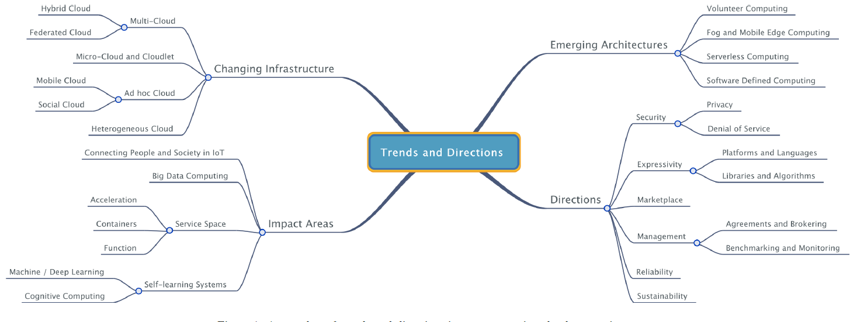
Directions in Cloud Architecture
Next Generation Cloud Computing: New Trends and Research Directions
Future Generation Computer Systems
Volume 79, Part 3, February 2018, Pages 849-861

Slide 18
Emerging Service Models
Heterogeneous computing – the cloud becomes a much richer environment with a wider selection of resources available.
  Acceleration as a Service
    Cloud Providers move from generic hardware to a richer variety of hardware accelerators – GPUs, FPGAs, and custom ASICs such as Tensor Processing Units.
  Container as a Service
      The basic resource becomes a container as opposed to a virtual machine e.g. Docker
  Function as a Service
      Serverless computing – resources are only used on-demand to run a function. There is no VM being held by the user. e.g. Lambdas

Slide 19
Emerging Deployment Models
Micro-Cloud:
  Support computing models where latency is a concern, edge or fog computing
Ad-Hoc Cloud:
  Users/organizations make available underutilized resources.
    Social Cloud computing – users interested in a cause share resources
    Volunteer computing – owners make available their extra-capacity with no guarantees of long term availability
    Many issues need to be resolved before this sees wide adoption:
      Security
      Device entering and leaving at random points in time
      Compensation for usage, energy, cell data, etc

Slide 20
Continued Evolution of Computing
Centralized mainframes to smaller department computers to desktop models
Cloud computing reversed this trend pushing for consolidation of resources. Addressing issues of cost and maintenance.
New models are now evolving that push processing from the cloud back closer to the user.
Even with the current push towards edge computing, a huge amount of compute power goes underutilized in each person’s pocket. A typical cell phone’s usage is at most 25%, leaving lots of cycle wasted.
Can this resource be leveraged? And, if so, how will the owner be compensated?
Or will needs and usage patterns change drastically in the coming years and necessitate new models of computing.

